Slide 1

SMART CASING FOR SMARTPHONES
UNDER THE SUPERVISION OF :
Dr. SUDIPTO MUKHERJEE
Varan Gupta – 2013ME10737
Rishabh Baid– 2013ME10712

Slide 2

What we propose?
We aim to eliminate the damage to mobile phones from accidental drop using protective casing.
Protective casing will be:
Capable of protecting phone from major damage for drops up to 4-6ft.
Cost-effective, aesthetically pleasing and light weight.
Capable of being developed into mass production product.
http://www.kidozen.com/mobile-security-doesnt-need-to-be-hard/

Slide 3
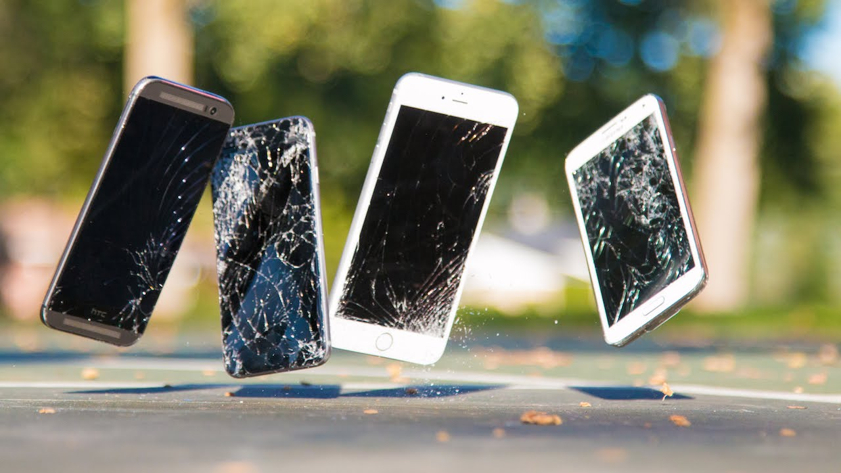
Why?
Many a times we happen to accidentally drop our phones and further to heighten our agony it falls with screen facing the ground.
With screen being fragile and the most worthy component its repair expense tends to break even with the current market value of the phone.
According to smartphone insurance site ‘MobileInsurance.co.uk’ , 23% of Phone users have cracked or smashed screens.
http://www.iphone6malaysia.com/uncategorized/ultimate-iphone-6-iphone-6-plus-drop-test-vs-samsung-galaxy-s5-htc-one-m8.html

Slide 4
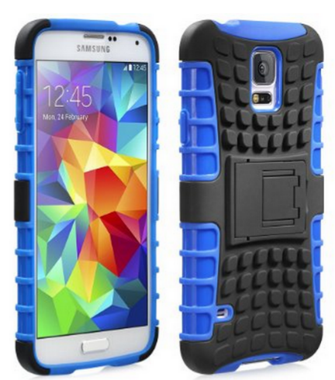
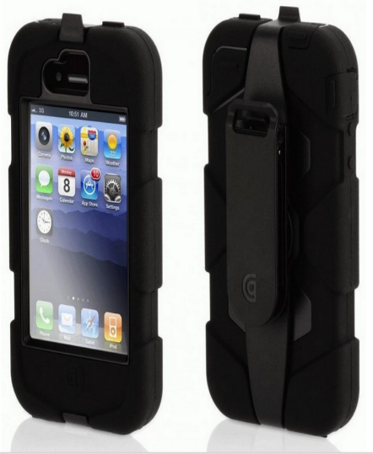
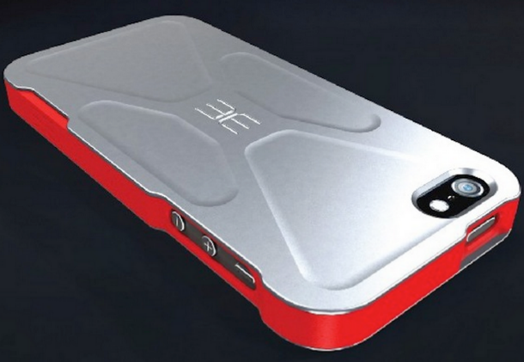
Existing products
Fosmon® Mobile Case
Not capable of saving the screen
Aesthetically not good
Cost : Rs.1500
Griffin Survivor iPhone 5 Case
Provides good protection
But its bulky
Only available for iPhone
Cost : Rs.3600
Edge Design AKTIV iPhone 5 Case
Provides good protection
Only available for iPhone
Cost : Rs.6100
http://www.amazon.co.uk/Fosmon%C2%AE-Samsung-Galaxy-HYBO-RAGGED-Protection/dp/B00I9K6Q3S/ref=sr_1_15?s=telephone&ie=UTF8&qid=1424432509&sr=1-15
http://www.gadgetreview.com/2012/12/12-of-the-toughest-iphone-5-cases

Slide 5
Related work
Apple, in its patent document proposed few solutions :
Reorienting the I-phone by altering its angular momentum in mid-flight via rotating or linearly sliding masses so as to save screen from impact.
Screen will saved but other parts will be damaged.
Using motors for extending and retracting aerodynamic surfaces for controlled landings.
Not effective for velocities and heights with which phones generally fall.
Using miniaturized gas canisters that exert thrust forces to slow down a fall.
Using gas canisters is also not feasible because they would have to be refilled every time the phone drops.

Slide 6
Deliverable
A generic mobile casing within a range of Rs.1000-2000 especially for Indian market.
It would incorporate
A detection system which will monitor the state of phone and will trigger the protection mechanism in the event of fall.
A protection mechanism capable of protecting phone falling with any orientation from impact.

Slide 7
Process flow chart
Detection of fall
Sending result to case
Triggering of protection mechanism
Protection mechanism

Slide 8
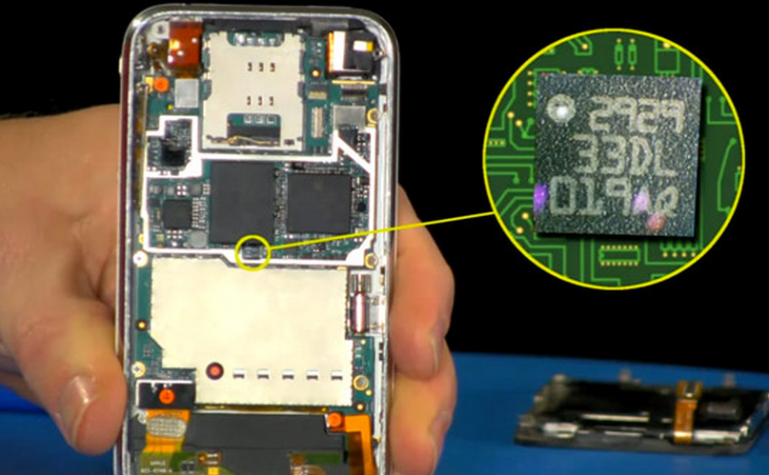
How to detect free fall?
Firstly we need to detect whether the phone is in freefall or not.
It can be accomplished using in-built accelerometer present in the smartphone.
http://www.engadget.com/2012/05/22/the-engineer-guy-shows-how-a-smartphone-accelerometer-works/

Slide 9
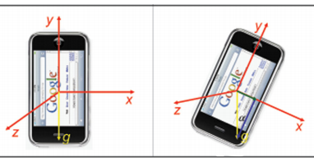
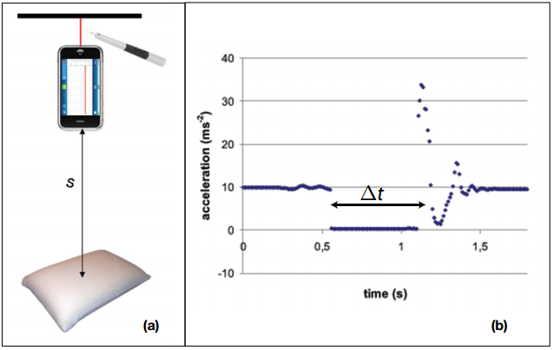
Accelerometer
When stationary, the accelerometer measures an acceleration g (= 9.81m/s²) distributed among the three axis depending on the orientation of the phone.
g
g
Whereas, in state of free fall the acceleration measured by all the three axis converges to 0.
Generally sampling rate of accelerometer of phone is about 200Hz and using 5 samples, fall will be detected within 25ms.
https://www.aapt.org/Resources/upload/PTE000182.pdf

Slide 10
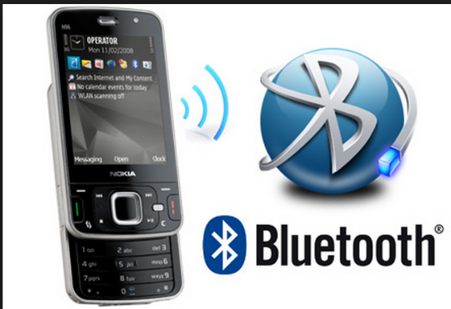
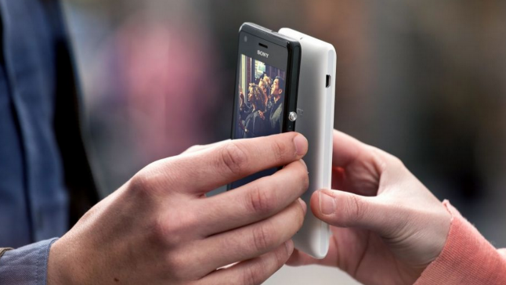
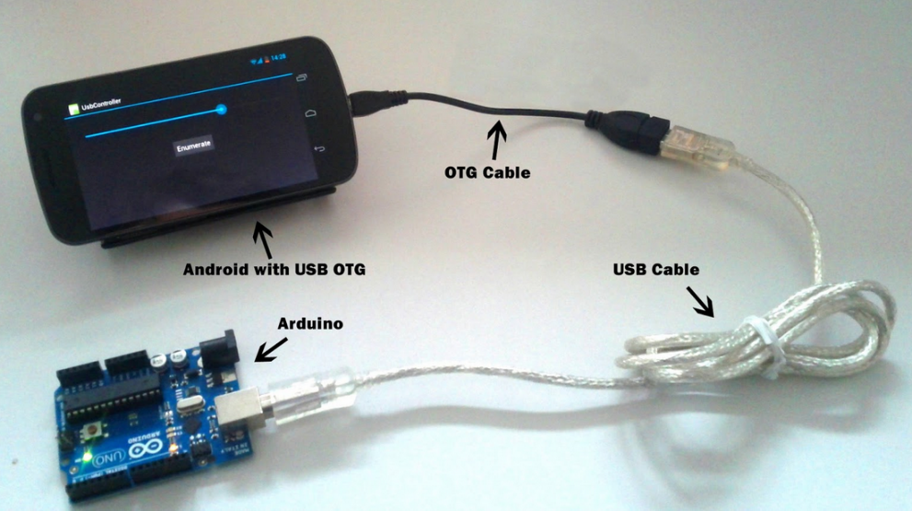
Sending results to case
Communication between phone and case can be achieved via:-
Bluetooth
NFC (Near Field Communication)
USB
http://technoblog.in/internet/
http://www.sunnysoft.cz/zbozi/062ZSO-219/sony-xperia-m-bila.html
http://fablab.ruc.dk/how-to-connect-android-to-arduino-via-usb-on-the-go/

Slide 11
USB is best solution
Because disadvantages in using NFC or Bluetooth are:-
Extra hardware will be required in the case.
Extra energy will be consumed.
Using them will cease communication of phone with other devices.
Whereas if we use USB :-
Results can be directly send to microcontroller of the case via serial communication at a baud rate of 9600bits/s without any extra hardware.
Also the need of another energy source for the case will be eliminated.

Slide 12
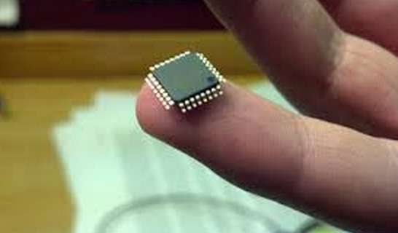
Triggering of protection mechanism
After free fall is detected , the phone will send signal to microcontroller of the case.
Once the signal is received , the microcontroller will trigger the actuator drivers controlling the protection mechanism.
http://kylepollard.blogspot.in/p/arduino-nano-clone.html

Slide 13
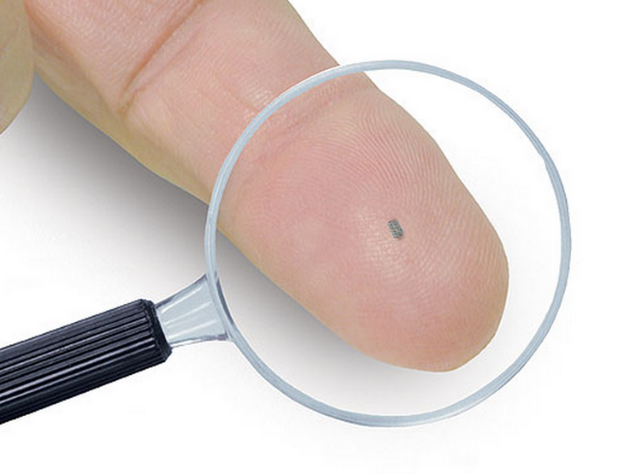
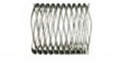
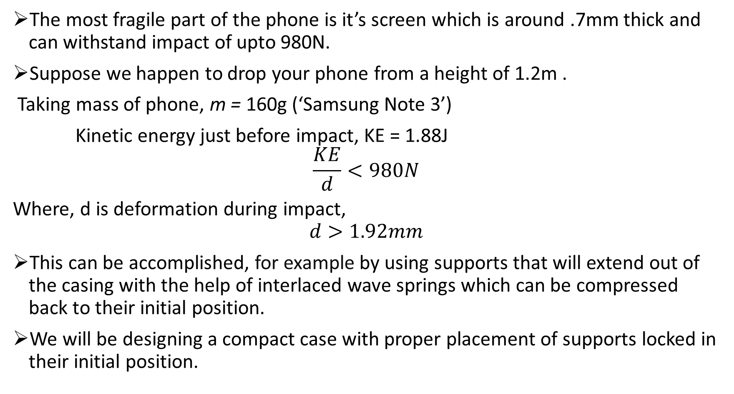
Protection mechanism
The most fragile part of the phone is it’s screen which is around .7mm thick and can withstand impact of upto 980N.
Suppose we happen to drop your phone from a height of 1.2m .
Taking mass of phone, m = 160g (‘Samsung Note 3’)
Kinetic energy just before impact, KE = 1.88J
$$\frac{KE}{d}<980N$$
Where, d is deformation during impact,
$$d>1.92mm$$
This can be accomplished, for example by using supports that will extend out of the casing with the help of interlaced wave springs which can be compressed back to their initial position.
We will be designing a compact case with proper placement of supports locked in their initial position.
http://www.designworldonline.com/lee-spring-grows-catalog-by-going-smaller/

Slide 14
Timeline
12 days
15 days
9 days
13 days
Idea Screening
Coming up with new ideas and then based on their viability choosing the best one
5 days
Concept development
We need to focus on mainly two areas-:
1) Computation 2)Mechanical Design
Proof of concept
Establishing the viability and feasibility of finalized concepts.
Designing & Manufacturing
Finalizing the final layout of case so as to accommodate the protection mechanism as well as being aesthetically pleasing.
Testing & Improvement
After analyzing the test results we would carry out the necessary iterations in design.We plan to implement machine learning to reduce false triggering .

Slide 15
Budget Breakup
S. No. | Component | Estimated cost (INR)
1. | Accelerometer adxl335 and Gyroscope gy-521 module* | 475
2. | Beaglebone (microprocessor)* | 4000
3. | Interlaced wave springs [8] | 400
4. | Android phone | 5000
5. | Actuators and Drivers | 2000
6. | Microcontroller | 175
7. | Miscellaneous | 2000
 | Total | 14050
*Although our eventual case would use already present sensors and processor in mobile phone for functioning but for testing purposes we will require to purchase them.

Slide 16
Thank You

